Slide 1
Dockers & Kubernetes
Introduction to Kubernetes

Slide 2
Session Agenda
Kuberentes Introduction
Need for Orchestration
Components of Kubernetes
Kubernetes Architecture
How to install Kubernetes:
Kubeadm and MiniKube
Introduction to Kubectl
Kubectl Commands

Slide 3
Need for Orchestration
When we have very few applications running, we can manage
and scale those applications manually as per the traffic
demand with the help of basic tools.
Imagine a scenario where we have hundreds of applications
which are made up of thousands of microservices. In this case,
with out a Container Orchestration engine it is impossible to
manage them..

Slide 4
Container Orchestration engine
Is a tool to automate deploying, scaling and managing
containerized applications at a large scale in dynamic
environment.
Features are:
Clustering
Scheduling
Scalability
Load Balancing
Fault Tolerance
Multiple ways of Deployment

Slide 5
Container Orchestration engine
There are many container orchestration tools available. Popular
among them are:
Kubernetes
Docker Swarm
Apache Mesos

Slide 6
Kubernetes
Kubernetes is an open source container orchestration
platform, used for deploying, scaling, updating and managing
containerized applications.
It was developed by Google and is now maintained by
CNCF(Cloud Native Computing Foundation).
K8s is a short form for Kubernetes

Slide 7
Features of Kubernetes
Load balancing
Storage orchestration
Automated rollouts and rollbacks
Automatic bin packing
Self-healing
Secret and configuration management

Slide 8
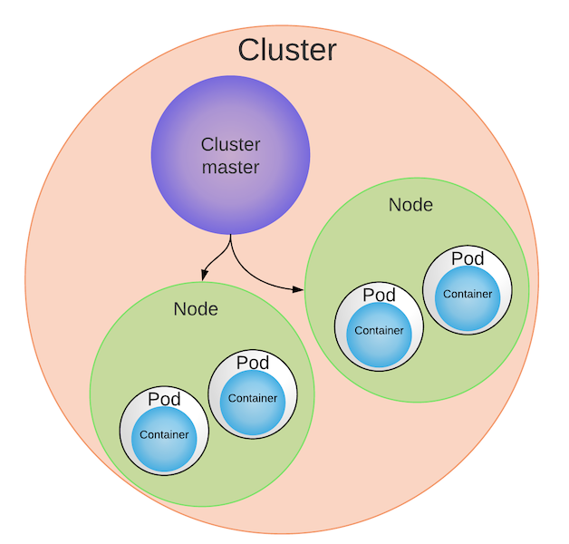
Kubernetes Architecture

Slide 9
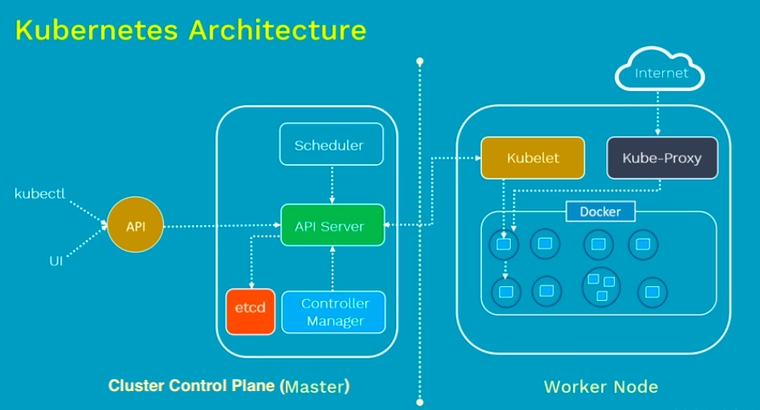
Kubernetes Components

Slide 10
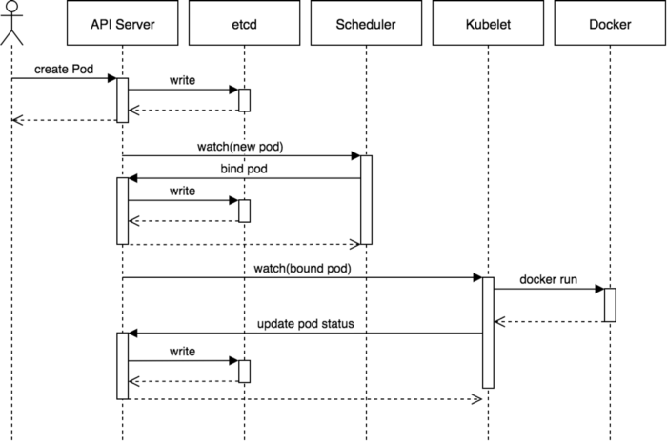
Pod creation Request flow

Slide 11
Kubernetes Installation
Can be installed using :
Minikube
Kubeadm
Cloud based platforms:
Google Kubernetes Engine
Amazon EKS
Azure Kubernetes Service

Slide 12
Kubernetes Installation Steps
Below is the url which can be used to follow the instructions for
installation of Kubernetes on Linux:
https://www.edureka.co/blog/install-kubernetes-on-ubuntu
Below is the url which can be used to follow the instructions for
installation of Kubernetes on Windows:
https://dzone.com/articles/setting-up-kubernetes-k8s-on-windows

Slide 13
Kubectl
It is a command line utility for running commands against
Kubernetes Clusters.
We use kubectl command in kubernetes for creating, updating,
displaying and even deleting any kubernetes objects in
kubernetes.
Kubectl syntax:
kubectl [command] [TYPE] [NAME] [flags]

Slide 14
Kubectl commands

Slide 15
Useful links
Url for Kubernetes playground
https://labs.play-with-k8s.com/
Url for play with Kubernetes classroom which has guided scenario
based exercises
https://training.play-with-kubernetes.com/
Urls for Katacoda exercises:
For single node cluster:
https://www.katacoda.com/courses/kubernetes/launch-single-node-cluster
For multi node cluster:
https://www.katacoda.com/courses/kubernetes/getting-startedwith-kubeadm

Slide 16
Thank you!

